Slide 1
A banking solution provider Company
Installation of Apigee OPDK in HA configuration across datacenter
Business Premise/Challenges
Solution
Post demerge with Parent organization ,customer Apigee implementation need to be moved out to a separate installation
Looking for a partner to quickly build up the Apigee platform and make it operational
Require an installation topology with HA and cost effective as their projected throughout are less
Want to install the Apigee product on non-supported linux version
Intelliswift proposed and implemented Apigee OPDK topology with minimum required nodes to achieve HA and meet customer’s throughput projection for 2 years.
The Apigee OPDK topology consists of a 10 nodes setup across 2 datacenter in HA
Closely worked with customer infrastructure team on Load balancer changes and required networking ports configuration to access cross DC nodes
Customer environment has mandatae Oracle linux VM, which is not one of the supported version of Apigee product installation, Intelliswift mitigate the risk of by manually installing required OS level libraries
Provided complete documentation docket with Installation runbook, upgrade and patching runbook, API deployment guide and process, API retirement guide and process, API deployment checklist
Configured Customer LDAP with roles mapping driven from Active Directory for Apigee user login.
Results
Operationalize Apigee OPDK with HA functionality within projected timelines and efforts
Knowledge base with all documentation to upgrade, self-service monitoring and maintenance of platform
Upscaling customer team by providing KT to manage, scale and maintain Apigee Platform
Technology Stack
Apigee OPDK
Oracle Linux
Team and Duration
2 Associates
7 weeks duration

Slide 2
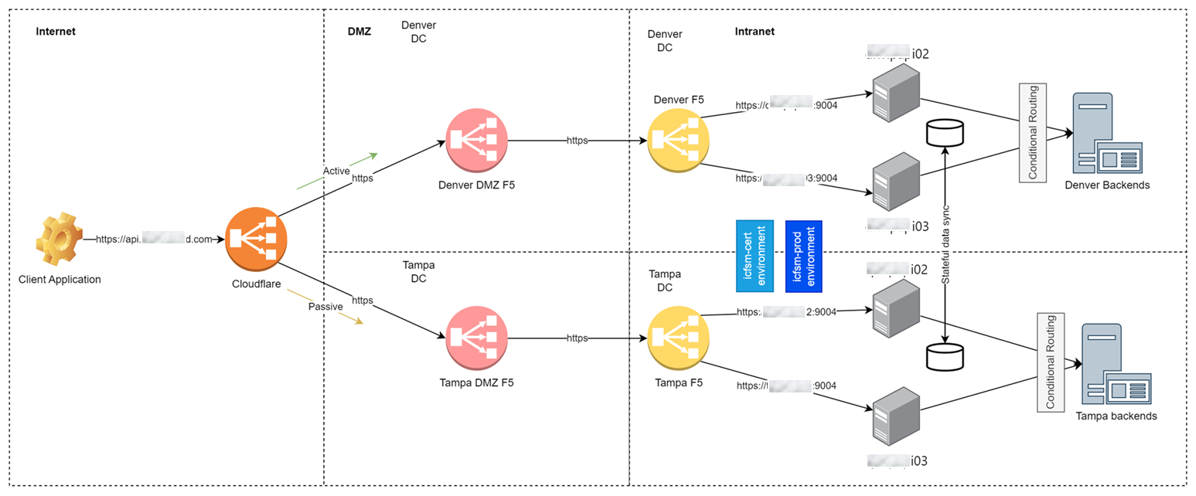
Network and Data flow
Active – Passive implementation between Denver and Tampa DCs
Both Denver and Tampa should share configuration for seamless customer experience in case of DR such token and API keys
Tampa DC should only connect to Tampa backends
Denver DC should only connect to Denver backends

Slide 3
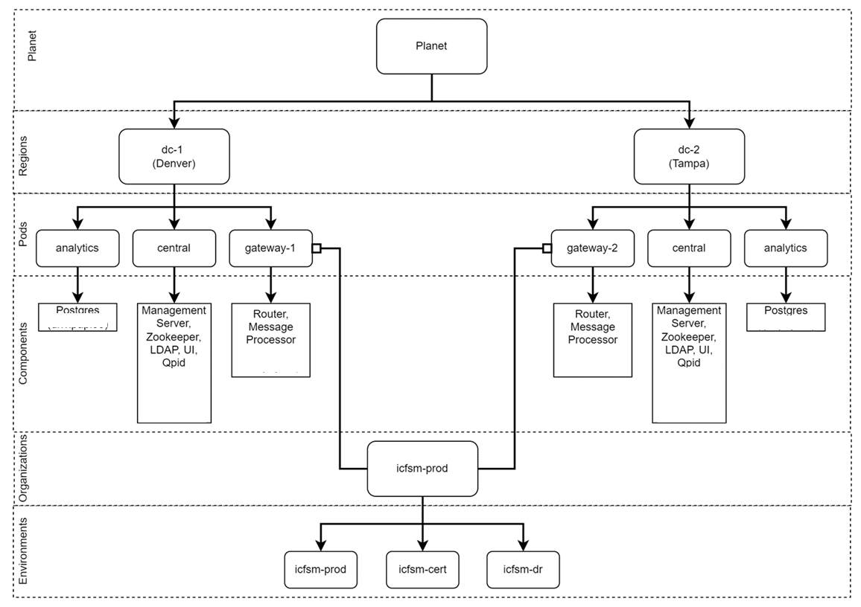
Apigee topology
5 node on each region “dc-1” and “dc-2” for 3 pods analytics, central and gateway
1 Production Org with 2 environments as “prod” and “cert”. It servers both prod, cert and dr proxies
Integrated with LDAP over SSL for Apigee user authentication
Implemented apigee-monit utility
Postgres analytics backup with a monthly job
Healthcheck API proxies implemented
Provision to offload environment from specific message processor for traffic-isolation

